Slide 1
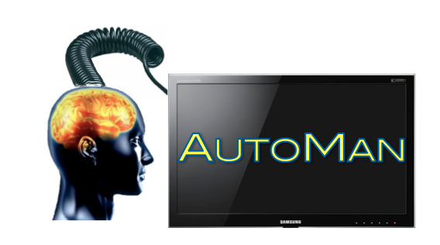
A Platform for Integrating Human-Based and Digital Computation
Emery Berger, Dan Barowy, Andrew McGregor University of Massachusetts, Amherst

Slide 2
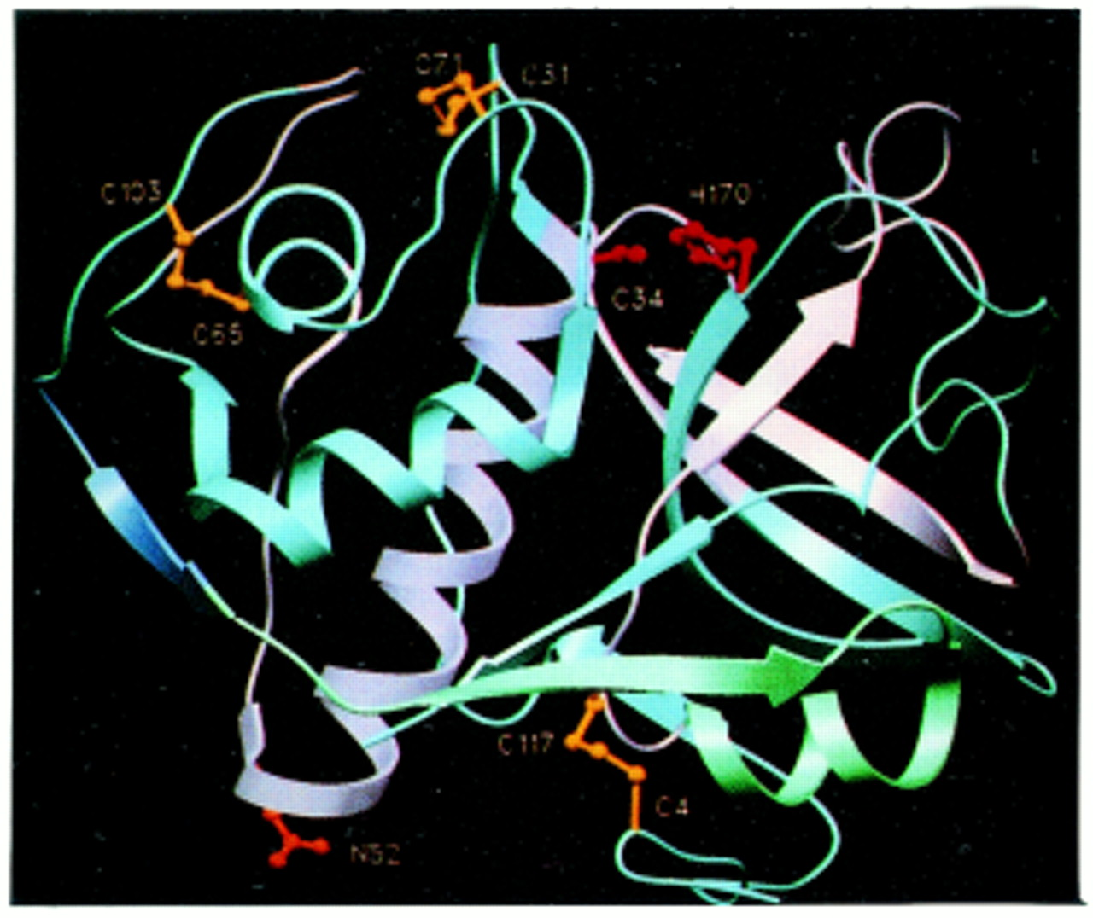
Notes:
Digital computation – success story. Lots of great stuff like decoding the human genome

Slide 3
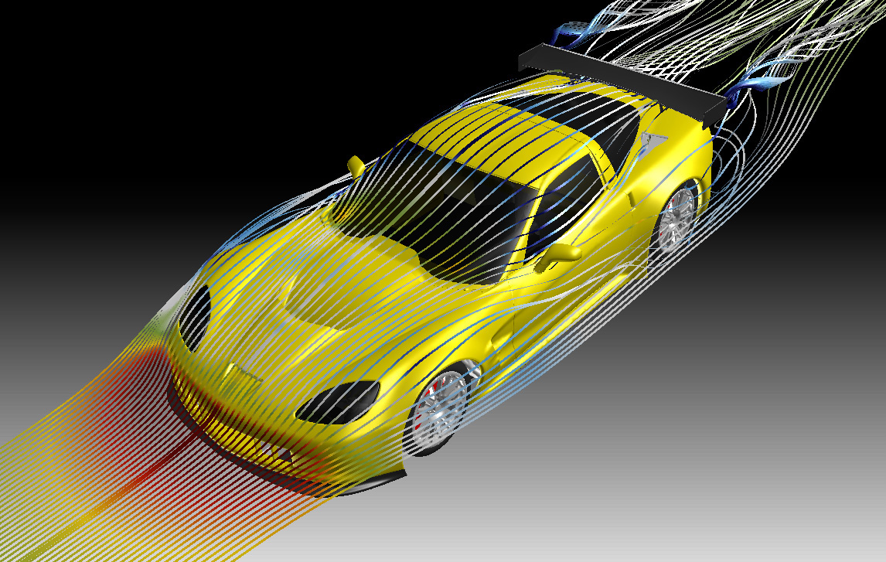
Notes:
Computers great at some things – aerodynamic simulation

Slide 4
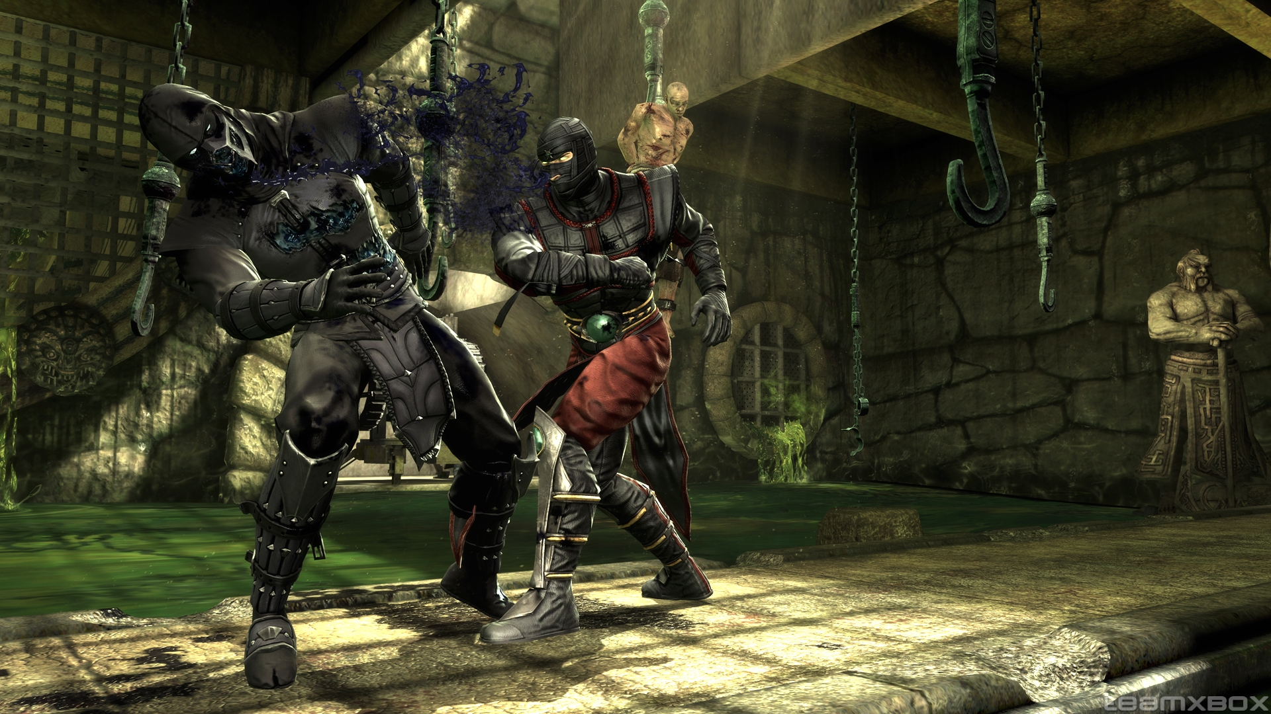
Notes:
3D simulations

Slide 5
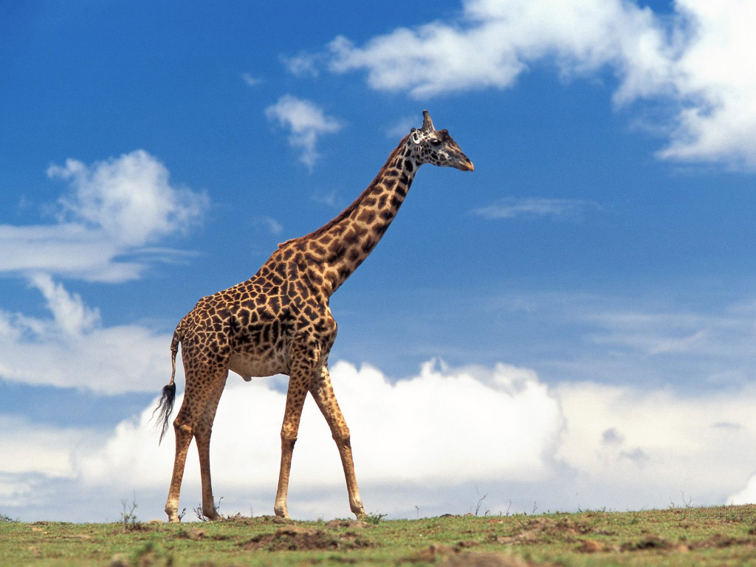
Notes:
Computers not so good at other tasks

Slide 6
“is this a giraffe?”
Notes:
Computers not so good at other tasks

Slide 7
isGiraffe(image)
Notes:
Can’t just call this function. What’s the answer?

Slide 8
isGiraffe( )

Slide 9
isGiraffe( )

Slide 10
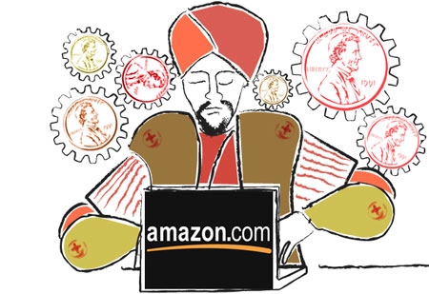
isGiraffe( )

Slide 11
isGiraffe( )
True
Notes:
Great – but lots of challenges.

Slide 12

isGiraffe( )
True
Notes:
You have to pay workers. How much should you pay?

Slide 13
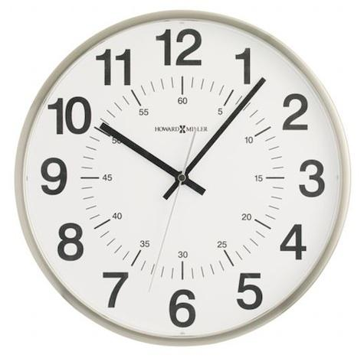
isGiraffe( )
True
Notes:
How long should the task take?

Slide 14
isGiraffe( )
False
Notes:
And most importantly, how do we know the answer is right? What if they answer incorrectly?

Slide 15

isGiraffe( )
False
Notes:
We need *confidence* in our results. People might just guess!

Slide 16
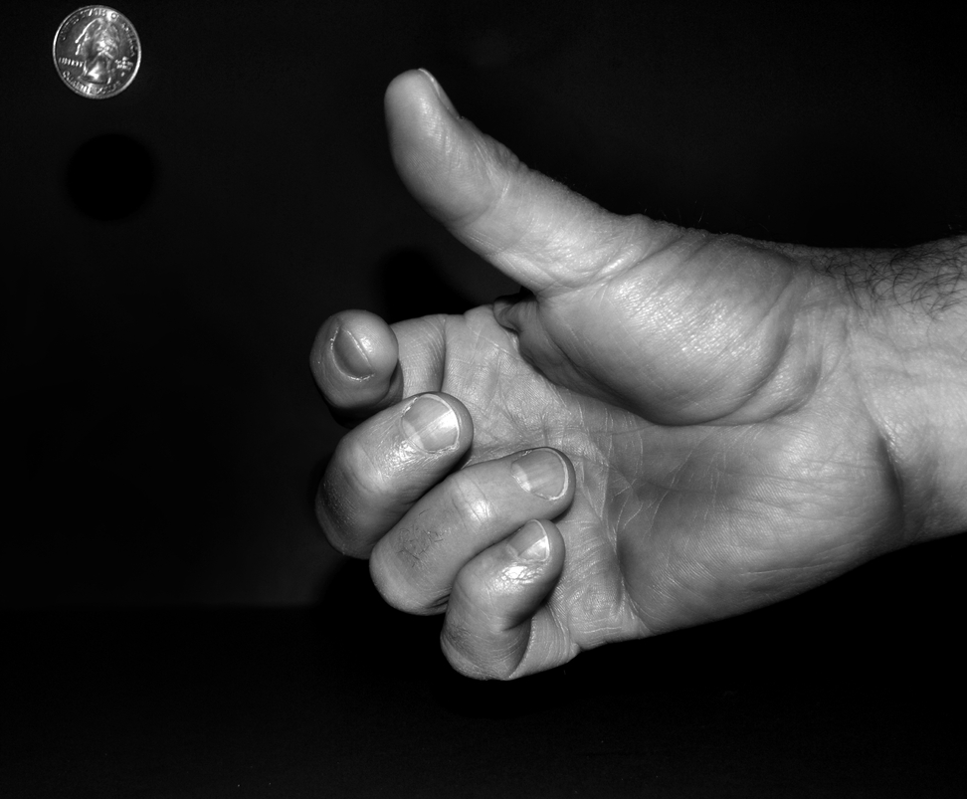
Notes:
Workers can be lazy and might just guess the answer

Slide 17
isGiraffe( )
?

Slide 18
isGiraffe( )

Slide 19
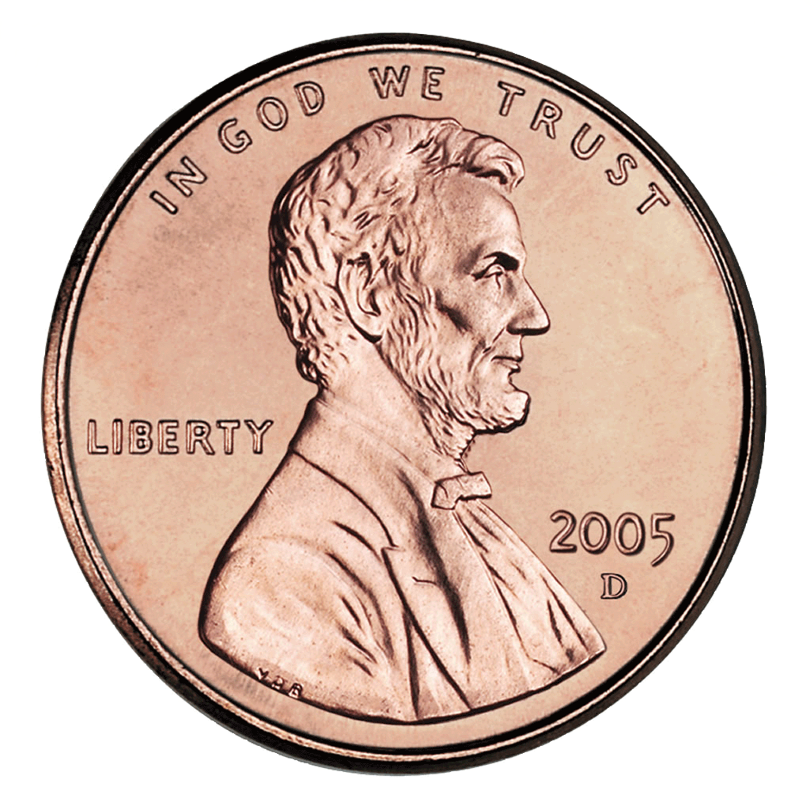

isGiraffe( )

Slide 20
isGiraffe( )
P(agreement) = ½

Slide 21
isGiraffe( )
Notes:
We need *confidence* in our results.
AutoMan automatically handles all of these problems.

Slide 22

isGiraffe( )
( )
Notes:
We need *confidence* in our results.
AutoMan automatically handles all of these problems.

Slide 23
isGiraffe( )
US minimum wage,
Adaptive doubling
Notes:
We need *confidence* in our results.
AutoMan automatically handles all of these problems.

Slide 24
isGiraffe( )
True
95% confidence
Notes:
We need *confidence* in our results.
AutoMan automatically handles all of these problems.

Slide 25
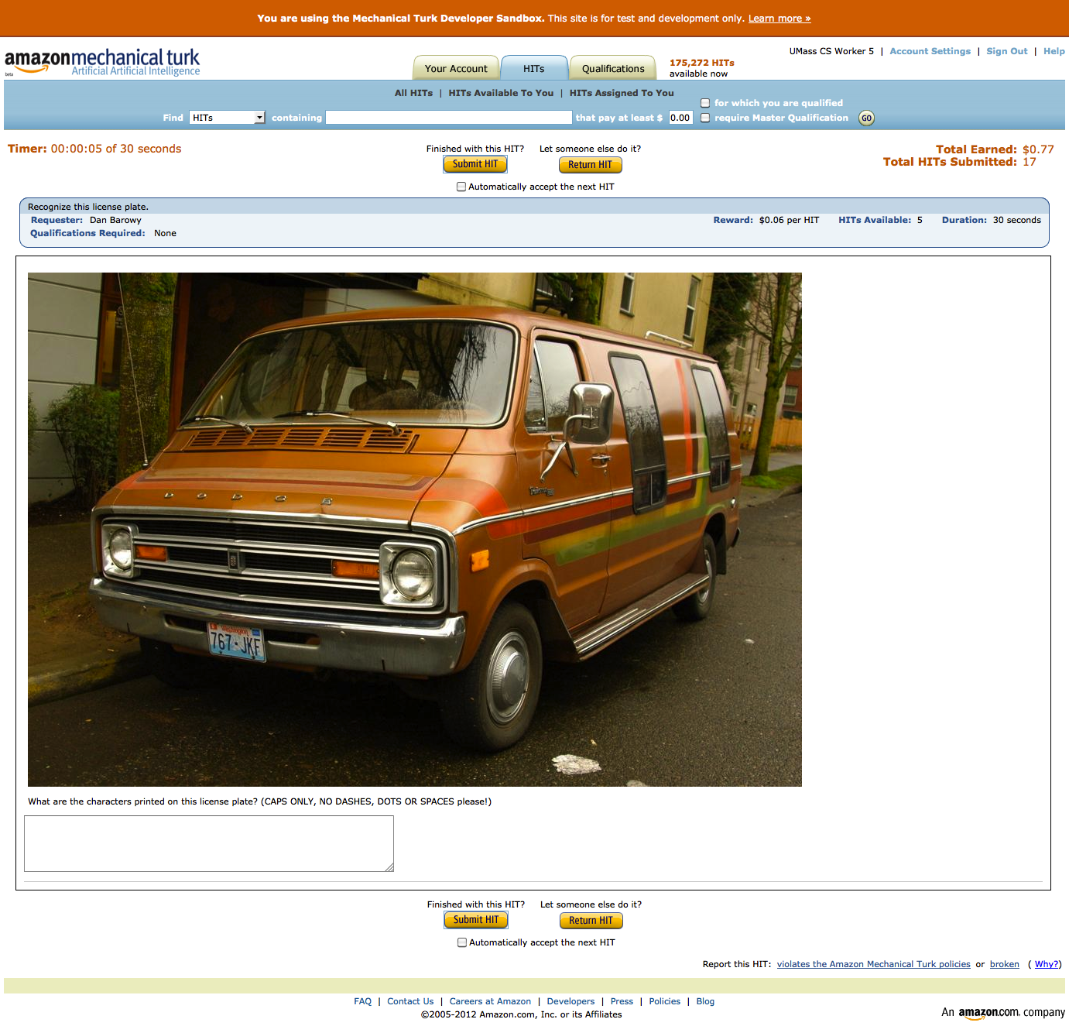

Slide 26
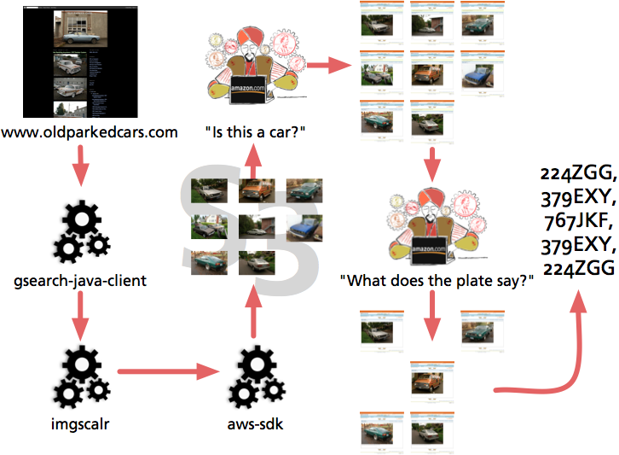

Slide 27
def is_readable_plate(image_url: String) = {
a.Task[String] { t =>
t.question = a.MultipleChoiceQuestion (
question_text = "Does this image PRIMARILY SHOW a vehicle with a CLEARLY READABLE license number plate?",
selection_texts = Map('yes -> "Yes.", 'no -> "No."))
t.question.image_url = image_url
}.apply("")
}

Slide 28
def get_plate_text(image_url: String) = {
a.Task[String] { t =>
t.confidence = 0.90
t.title = "Recognize this license plate.”
t.question =
a.FreeTextQuestion("What are the characters printed on this license plate? (CAPS ONLY, NO DASHES, DOTS OR SPACES please!)")
t.question.num_choices = BigInt(36).pow(6)
// [A-Z0-9]
t.question.image_url = image_url
}.apply("")
}

Slide 29
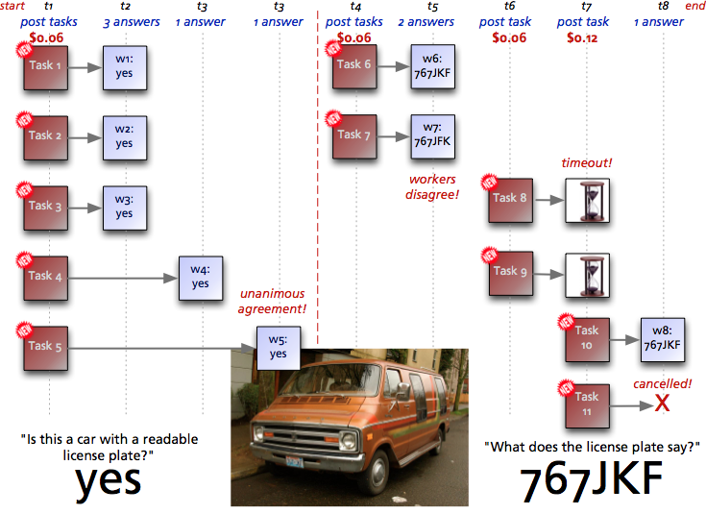

Slide 30
www.automan-lang.org

Slide 31
